Slide 1
Chapter 7: Database Design Using the E-R Model

Slide 2
Outline
Overview of the Design Process
The Entity-Relationship Model
Complex Attributes
Mapping Cardinalities
Primary Key
Removing Redundant Attributes in Entity Sets
Reducing ER Diagrams to Relational Schemas
Extended E-R Features
Entity-Relationship Design Issues
Alternative Notations for Modeling Data
Other Aspects of Database Design

Slide 3
Design Phases
The task of creating a database application is a complex one, involving
  design of the database schema,
  design of the programs that access and update the data, and
  design of a security scheme to control access to data.
The needs of the users play a central role in the design process.
Initial phase -- characterize fully the data needs of the prospective database users.
Second phase -- choosing a data model
  Applying the concepts of the chosen data model
  Translating these requirements into a conceptual schema of the database.
  A fully developed conceptual schema indicates the functional requirements of the enterprise.
    Describe the kinds of operations (or transactions) that will be performed on the data.

Slide 4
Design Phases (Cont.)
Final Phase -- Moving from an abstract data model to the implementation of the database
  Logical Design – Deciding on the database schema.
    Database design requires that we find a “good” collection of relation schemas.
    Business decision – What attributes should we record in the database?
    Computer Science decision – What relation schemas should we have and how should the attributes be distributed among the various relation schemas?
  Physical Design – Deciding on the physical layout of the database

Slide 5
Design Alternatives
In designing a database schema, we must ensure that we avoid two major pitfalls:
  Redundancy: a bad design may result in repeat information.
    Redundant representation of information may lead to data inconsistency among the various copies of information
  Incompleteness: a bad design may make certain aspects of the enterprise difficult or impossible to model.
Avoiding bad designs is not enough. There may be a large number of good designs from which we must choose.

Slide 6
Design Approaches
Entity Relationship Model (covered in this chapter)
  Models an enterprise as a collection of entities and relationships
    Entity: a “thing” or “object” in the enterprise that is distinguishable from other objects
      Described by a set of attributes
    Relationship: an association among several entities
  Represented diagrammatically by an entity-relationship diagram:
Normalization Theory (Chapter 7)
  Formalize what designs are bad, and test for them

Slide 7
The Entity-Relationship Model
The entity-relationship (E-R) data model was developed to facilitate database design by allowing specification of an enterprise schema that represents the overall logical structure of a database.
The E-R model is very useful in mapping the meanings and interactions of real-world enterprises onto a conceptual schema.
Because of this usefulness, many database-design tools draw on concepts from the E-R model.
The E-R data model employs three basic concepts:
  entity sets,
  relationship sets, and
  attributes
The E-R model also has an associated diagrammatic representation, called the E-R diagram.

Slide 8
Entity
A database can be modeled as:
  a collection of entities,
  relationship among entities.
Entity
An entity is a “thing” or “object” in the real world that is distinguishable from all other objects.
  Example: specific person, company, event, plant
An entity has a set of properties and the values for some set of properties (attributes) may uniquely identify an entity.
  Example: person (person_id, person_name, address)
  Example: course (course_id, course_name, department, credits)
An entity may be concrete, such as a person or a book, or it may be abstract, such as loan, or a holiday, or a concept.

Slide 9

Entity Set
Entity Set: An entity set is a set of entities of the same type that share the same properties or attributes.
  Example: set of all persons, companies, trees, holidays
Entity sets do not need to be disjoint. For example, it is possible to define the entity set of all people in a university (person). A person entity may be an instructor entity, a student entity, both, or neither.
instructor_ID instructor_name student_ID student_name

Slide 10
Attributes
An entity is represented by a set of attributes, that is descriptive properties possessed by all members of an entity set.
The designation of an attribute for an entity set expresses that the database stores similar information concerning each entity in the entity set; however, each entity may have its own value for each attribute.
  Example:
  instructor = (ID, name, street, city, salary )
  course= (course_id, title, credits)
Domain – the set of permitted values for each attribute
  customer_name – Set of all text strings of a certain length
A database thus includes a collection of entity sets, each of which contains any number of entities of same type.

Slide 11
Attribute Types
Simple and composite attributes.
  Simple – When an attribute is not possible to divide into subparts, customer city, country
  Composite – Composite attributes can be divided into subparts i.e. other attributes. Composite attributes help us to group together the related attributes, making the modeling cleaner.
  name – first_name, middle_name, last_name
  address – street, city, state, zip_code (postal code)
  street – street_number, street_name, apartment_number
Single-valued and multivalued attributes
  Single-valued – when there exist a single value for a particular entity
    Example: course_name, salary
  Multivalued - When there exist a set of values for a specific entity
    Example: phone_numbers, dependent_names

Slide 12

Composite Attributes

Slide 13
Attribute Types
  An instructor may have zero, one, or several phone numbers, and different instructors may have different numbers of phones.
  Where appropriate, upper and lower bounds may be placed on the number of values in a multivalued attribute. For example, a university may limit the number of phone numbers recorded for a single instructor to two.
Derived attributes
  Derived attributes - The value of this type of attribute can be derived from the values of other related attributes or entities.
  The value of a derived attribute is not stored, but is computed when required.
    Example: age, given date_of_birth
    Example: loan_held, given a customer’s all loans
    Example: service_length, given date_of_joining

Slide 14
7.2.2 Relationship Sets
A relationship is an association among several entities
Example:
44553 (Peltier) advisor 22222 (Einstein)
student entity relationship set instructor entity
A relationship set is a set of relationships of the same type. Formally, it is a mathematical relation among n ≥ 2 (possibly non-distinct) entities.
If E₁, E₂, . . . , E_{n} are entity sets, then a relationship set R is a subset of
{(e₁, e₂, … e_{n}) | e₁ ∈ E₁, e₂ ∈ E₂, …, e_{n} ∈ E_{n}}
where (e₁, e₂, …, e_{n}) is a relationship
  Example:
  (44553,22222) ∈ advisor

Slide 15

Relationship Sets (Cont.)
The relationship set advisor to denote the association between instructors and students.
The relationship set takes to denote the association between a student and the course sections in which that student is enrolled.

Slide 16

Relationship Sets (Cont.)
An attribute can also be property of a relationship set.
For instance, the advisor relationship set between entity sets instructor and student may have the attribute date which tracks when the student started being associated with the advisor.

Slide 17
Degree of a Relationship Set
Binary relationship
  involve two entity sets (or degree two).
  most relationship sets in a database system are binary.
Relationships between more than two entity sets are rare. Most relationships are binary. (More on this later.)
  Example: students work on research projects under the guidance of an instructor.
  relationship proj_guide is a ternary relationship between instructor, student, and project

Slide 18
Mapping Cardinality Constraints
Express the number of entities to which another entity can be associated via a relationship set.
Most useful in describing binary relationship sets.
For a binary relationship set the mapping cardinality must be one of the following types:
  One to one
  One to many
  Many to one
  Many to many

Slide 19

Mapping Cardinalities
One to one
One to many
Note: Some elements in A and B may not be mapped to any
elements in the other set

Slide 20

Mapping Cardinalities
Many to one
Many to many
Note: Some elements in A and B may not be mapped to any
elements in the other set

Slide 21
Keys
The values of the attributes of an entity must be such that they can uniquely identify the entity from the entity set.
In other words, no two entities in an entity set are allowed to have exactly the same value for all attributes.
A key allows us to identify a set of attributes that suffice to distinguish entities from each other.
Keys also help uniquely identify relationships, and thus distinguish relationships from each other.

Slide 22
Keys for Entity Sets
Superkey: A superkey is a set of one or more attributes that, taken collectively, allow identifying uniquely an entity in the entity set. A superkey may contain extraneous attributes.
  Exmp: instructor – {ID}, {ID, name}, {all attributes}
  name is not a superkey
Candidate key: The superkey, for which no proper subset is a superkey, is a candidate key. So the minimul superkeys are called candidate keys.
It is possible that several distinct sets of attributes could serve as a candidate key.
  ID is candidate key of instructor
  course_id is candidate key of course
Primary Key: The primary key is to denote a candidate key that is chosen by the database designer as the principal means of identifying entities within the entity set.
So, Primary key ⊆ Candidate Key ⊆ Super key

Slide 23
Keys for Relationship Sets
The combination of primary keys of the participating entity sets forms a super key of a relationship set.
  (s_id, i_id) is the super key of advisor
  NOTE: this means a pair of entity sets can have at most one relationship in a particular relationship set.
    Example: if we wish to track multiple meeting dates between a student and her advisor, we cannot assume a relationship for each meeting. We can use a multivalued attribute though
Must consider the mapping cardinality of the relationship set when deciding what are the candidate keys
Need to consider semantics of relationship set in selecting the primary key in case of more than one candidate key

Slide 24
Primary Key for Relationship Sets
To distinguish among the various relationships of a relationship set we use the individual primary keys of the entities in the relationship set.
  Let R be a relationship set involving entity sets E1, E2, .. En
  The super key for R consists of the union of the primary keys of entity sets E1, E2, ..En
  If the relationship set R has attributes a1, a2, .., am associated with it, then R also includes the attributes a1, a2, .., am
Example: relationship set “advisor”.
  The super key consists of instructor.ID and student.ID
The choice of the primary key for a relationship set depends on the mapping cardinality of the relationship set.

Slide 25
Choice of Primary key for Binary Relationship
Many-to-Many relationships. The preceding union of the primary keys is a minimal superkey and is chosen as the primary key.
One-to-Many relationships . The primary key of the “Many” side is a minimal superkey and is used as the primary key.
Many-to-one relationships. The primary key of the “Many” side is a minimal superkey and is used as the primary key.
One-to-one relationships. The primary key of either one of the participating entity sets forms a minimal superkey, and either one can be chosen as the primary key.

Slide 26
Redundant Attributes
Suppose we have entity sets
  instructor, with attributes including dept_name
  department
  and a relationship
  inst_dept relating instructor and department
Attribute dept_name in entity instructor is redundant since there is an explicit relationship inst_dept which relates instructors to departments
  The attribute replicates information present in the relationship, and should be removed from instructor
  BUT: when converting back to tables, in some cases the attribute gets reintroduced, as we will see.

Slide 27

E-R Diagrams
Rectangles represent entity sets.
Diamonds represent relationship sets.
Attributes listed inside entity rectangle
Underline indicates primary key attributes

Slide 28

Entity With Composite, Multivalued, and Derived Attributes

Slide 29

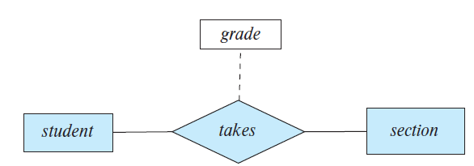
Relationship Sets with Attributes
Descriptive Attribute

Slide 30

Roles
Entity sets of a relationship need not be distinct
  Each occurrence of an entity set plays a “role” in the relationship
The labels “course_id” and “prereq_id” are called roles.

Slide 31
Constraints in E-R Model
An E-R enterprise schema may define certain constraints to which the contents of a database must conform. These are:
1. Mapping cardinalities or Cardinality ratios and
2. Participation constraints.

Slide 32
Cardinality Constraints
Express the number of entities to which another entity can be associated via a relationship set.
We express cardinality constraints by drawing either a directed line (→), signifying “one,” or an undirected line (—), signifying “many,” between the relationship set and the entity set.
One-to-one relationship:
  A student is associated with at most one instructor via the relationship advisor
  A student is associated with at most one department via stud_dept

Slide 33

One-to-One Relationship
one-to-one relationship between an instructor and a student
  an instructor is associated with at most one student via advisor
  and a student is associated with at most one instructor via advisor

Slide 34
One-to-Many Relationship
one-to-many relationship between an instructor and a student
  an instructor is associated with several (including 0) students via advisor
  a student is associated with at most one instructor via advisor,

Slide 35
Many-to-One Relationships
In a many-to-one relationship between an instructor and a student,
  an instructor is associated with at most one student via advisor,
  and a student is associated with several (including 0) instructors via advisor

Slide 36
Many-to-Many Relationship
An instructor is associated with several (possibly 0) students via advisor
A student is associated with several (possibly 0) instructors via advisor

Slide 37
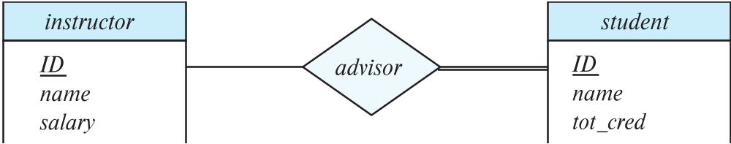
Participation of an Entity Set in a Relationship Set
Total participation (indicated by double line): every entity in the entity set participates in at least one relationship in the relationship set
  E.g., participation of section in sec_course is total
    every section must have an associated course
  E.g., participation of student in advisor relation is total
    every student must have an associated instructor
Partial participation: some entities may not participate in any relationship in the relationship set
  Example: participation of instructor in advisor is partial

Slide 38
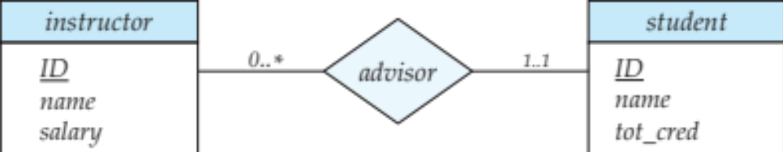
Notation for Expressing More Complex Constraints
A line may have an associated minimum and maximum cardinality, shown in the form l..h, where l is the minimum and h the maximum cardinality
  A minimum value of 1 indicates total participation.
  A maximum value of 1 indicates that the entity participates in at most one relationship
  A maximum value of * indicates no limit.
Example
  Instructor can advise 0 or more students. A student must have 1 advisor; cannot have multiple advisors

Slide 39

E-R Diagram with a Ternary Relationship

Slide 40
Cardinality Constraints on Ternary Relationship
We allow at most one arrow out of a ternary (or greater degree) relationship to indicate a cardinality constraint
E.g., an arrow from proj_guide to instructor indicates each student has at most one guide for a project
If there is more than one arrow, there are two ways of defining the meaning.
  E.g., a ternary relationship R between A, B and C with arrows to B and C could mean
  1. each A entity is associated with a unique entity from B and C or
  2. each pair of entities from (A, B) is associated with a unique C entity, and each pair (A, C) is associated with a unique B
  Each alternative has been used in different formalisms
  To avoid confusion we outlaw more than one arrow

Slide 41
How about doing an ER design interactively on the board?
Suggest an application to be modeled.

Slide 42
Weak Entity Sets
An entity set that does not have a primary key is referred to as a weak entity set.
The existence of a weak entity set depends on the existence of a identifying entity set
  It must relate to the identifying entity set via a total, one-to-many relationship set from the identifying to the weak entity set
  Identifying relationship depicted using a double diamond
The discriminator (or partial key) of a weak entity set is the set of attributes that distinguishes among all the entities of a weak entity set.
The primary key of a weak entity set is formed by the primary key of the strong entity set on which the weak entity set is existence dependent, plus the weak entity set’s discriminator.

Slide 43

Weak Entity Sets (Cont.)
We underline the discriminator of a weak entity set with a dashed line.
We put the identifying relationship of a weak entity in a double diamond.
Primary key for section – (course_id, sec_id, semester, year)

Slide 44
Weak Entity Sets (Cont.)
Note: the primary key of the strong entity set is not explicitly stored with the weak entity set, since it is implicit in the identifying relationship.
If course_id were explicitly stored, section could be made a strong entity, but then the relationship between section and course would be duplicated by an implicit relationship defined by the attribute course_id common to course and section

Slide 45
Weak Entity Sets (Cont.)
The identifying relationship set should have no descriptive attributes, since any required attributes can be associated with the weak entity set.
1. A weak entity set can participate in relationships other than the identifying relationship.
2. A weak entity set may participate as owner in an identifying relationship with another weak entity set.
3. It is possible to have a weak entity set with more than one identifying entity set. The primary key of the weak entity set would consist of the union of the primary keys of the identifying entity sets plus the discriminator of the weak entity set.

Slide 46

E-R Diagram for a University Enterprise

Slide 47

Schema Diagram for University Database

Slide 48
Reduction to Relational Schemas

Slide 49
Reduction to Relation Schemas
Entity sets and relationship sets can be expressed uniformly as relation schemas that represent the contents of the database.
A database which conforms to an E-R diagram can be represented by a collection of schemas.
For each entity set and relationship set there is a unique schema that is assigned the name of the corresponding entity set or relationship set.
Each schema has a number of columns (generally corresponding to attributes), which have unique names.
Both the E-R model and the relational database model are abstract, logical representations of real-world enterprises. Because the two models employ similar design principles, we can convert E-R design into a relational design.

Slide 50
Representing Entity Sets With Simple Attributes
A strong entity set reduces to a schema with the same attributes
course(course_id, title, credits)
A weak entity set becomes a table that includes a column for the primary key of the identifying strong entity set
section ( course_id, sec_id, sem, year )

Slide 51
Representing Relationship Sets
A many-to-many relationship set is represented as a schema with attributes for the primary keys of the two participating entity sets, and any descriptive attributes of the relationship set.
Example: schema for relationship set advisor
advisor = (s_id, i_id)

Slide 52
Redundancy of Schemas
Many-to-one and one-to-many relationship sets that are total on the many-side can be represented by adding an extra attribute to the “many” side, containing the primary key of the “one” side
Example: Instead of creating a schema for relationship set inst_dept, add an attribute dept_name to the schema arising from entity set instructor

Slide 53
Redundancy of Schemas (Cont.)
For one-to-one relationship sets, either side can be chosen to act as the “many” side
  That is, extra attribute can be added to either of the tables corresponding to the two entity sets
If participation is partial on the “many” side, replacing a schema by an extra attribute in the schema corresponding to the “many” side could result in null values
The schema corresponding to a relationship set linking a weak entity set to its identifying strong entity set is redundant.
  Example: The section schema already contains the attributes that would appear in the sec_course schema

Slide 54
Combination of Schemas
If there are two entity sets A and B and there exist relationship set R between those, 3 schemas A, B, R can be generated using relational-schema construction scheme.
1. one to one relationship from A to B - the primary key of R is either of the primary keys of participating entity sets (A or B)
  These can be combined into 2 schemas: AR, B or A, BR
2. one to many from A to B - the primary key of R is simply the primary key of B
  These can be combined into 2 schemas: A, BR
3. many to one from A to B - the primary key of R is simply the primary key of A
  These can be combined into 2 schemas: AR, B
4. many to many – the primary key of R consists of the union of the primary keys of A and B
  There is no other alternative but to keep all the 3 schemas.

Slide 55
Combination of Schemas (Cont.)
For all the above cases there should be total participation of the entity sets in the relationship set.
Combination of schemas works nicely in case of total participation.
If there exists partial participation and we combine the schemas there will be null values for some entities those do not participate in relationship.

Slide 56
Composite and Multivalued Attributes
Composite attributes are flattened out by creating a separate attribute for each component attribute
  Example: given entity set instructor with composite attribute name with component attributes first_name and last_name the schema corresponding to the entity set has two attributes name_first_name and name_last_name
    Prefix omitted if there is no ambiguity
Ignoring multivalued attributes, extended instructor schema is
  instructor(ID,
  first_name, middle_initial, last_name,
  street_number, street_name,
  apt_number, city, state, zip_code,
  date_of_birth)

Slide 57
Composite and Multivalued Attributes
A multivalued attribute M of an entity E is represented by a separate schema EM
  Schema EM has attributes corresponding to the primary key of E and an attribute corresponding to multivalued attribute M
  Example: Multivalued attribute phone_number of instructor is represented by a schema:
  inst_phone= ( ID, phone_number)
  Each value of the multivalued attribute maps to a separate tuple of the relation on schema EM
    For example, an instructor entity with primary key 22222 and phone numbers 456-7890 and 123-4567 maps to two tuples:
    (22222, 456-7890) and (22222, 123-4567)

Slide 58
Multivalued Attributes (Cont.)
Special case:entity time_slot has only one attribute other than the primary-key attribute, and that attribute is multivalued
  Optimization: Don’t create the relation corresponding to the entity, just create the one corresponding to the multivalued attribute
  time_slot(time_slot_id, day, start_time, end_time)
  Caution: time_slot attribute of section (from sec_time_slot) cannot be a foreign key due to this optimization

Slide 59

Design Issues
The notions of an entity set and a relationship set are not precise and it is possible to define a set of entities and the relationships among them in a number of different ways.
1. Use of Entity Sets Vs Attributes
- What constitutes an attribute and what constitutes an entity set?
2. Use of Entity Sets Vs Relationship Sets
3. Binary Vs n-ary Relationship Sets
4. Placement of Relationship Attributes (Descriptive attributes)
Use of entity sets vs. attributes
Use of phone as an entity allows extra information about phone numbers (plus multiple phone numbers)

Slide 60

Design Issues
Use of entity sets vs. relationship sets
Possible guideline is to designate a relationship set to describe an action that occurs between entities

Slide 61
Design Issues
Binary versus n-ary relationship sets
Although it is possible to replace any nonbinary (n-ary, for n > 2) relationship set by a number of distinct binary relationship sets, a n-ary relationship set shows more clearly that several entities participate in a single relationship.
Placement of relationship attributes
e.g., attribute date as attribute of advisor or as attribute of student
a) Attributes of a one to many relationship set can be repositioned to only the entity set on the many side of the relationship
b) For one to one relationship sets, the relationship attribute can be associated with either one of the participating entity sets.
c) When an attribute is determined by the combination on participating entity sets, rather than by either entity separately, that attribute must be associated with the many to many relationship set.

Slide 62
Binary Vs. Non-Binary Relationships
Some relationships that appear to be non-binary may be better represented using binary relationships
  E.g., A ternary relationship parents, relating a child to his/her father and mother, is best replaced by two binary relationships, father and mother
    Using two binary relationships allows partial information (e.g., only mother being know)
  But there are some relationships that are naturally non-binary
    Example: proj_guide

Slide 63

Converting Non-Binary Relationships to Binary Form
In general, any non-binary relationship can be represented using binary relationships by creating an artificial entity set.
  Replace R between entity sets A, B and C by an entity set E, and three relationship sets:
1. R_{A}, relating E and A 2. R_{B}, relating E and B
3. R_{C}, relating E and C
  Create a special identifying attribute for E
  Add any attributes of R to E
  For each relationship (a_{i} , b_{i} , c_{i}) in R, create
1. a new entity e_{i} in the entity set E 2. add (e_{i} , a_{i} ) to R_{A}
3. add (e_{i} , b_{i} ) to R_{B} 4. add (e_{i} , c_{i} ) to R_{C}

Slide 64
Converting Non-Binary Relationships (Cont.)
Also need to translate constraints
  Translating all constraints may not be possible
  There may be instances in the translated schema that
  cannot correspond to any instance of R
    Exercise: add constraints to the relationships R_{A}, R_{B} and R_{C} to ensure that a newly created entity corresponds to exactly one entity in each of entity sets A, B and C
  We can avoid creating an identifying attribute by making E a weak entity set (described shortly) identified by the three relationship sets

Slide 65
Extended ER Features

Slide 66
Extended E-R Features: Specialization
Top-down design process: we designate sub-groupings within an entity set that are distinctive from other entities in the set.
These sub-groupings become lower-level entity sets that have attributes or participate in relationships that do not apply to the higher-level entity set.
Depicted by a triangle component labeled ISA (E.g., instructor “is a” person).
Attribute inheritance – a lower-level entity set inherits all the attributes and relationship participation of the higher-level entity set to which it is linked.

Slide 67

Specialization Example
Overlapping – employee and student
Disjoint – instructor and secretary
Total and partial

Slide 68
Extended ER Features: Generalization
A bottom-up design process – combine a number of entity sets that share the same features into a higher-level entity set.
Specialization and generalization are simple inversions of each other; they are represented in an E-R diagram in the same way.
The terms specialization and generalization are used interchangeably.

Slide 69
Specialization and Generalization (Cont.)
Can have multiple specializations of an entity set based on different features.
E.g., permanent_employee vs. temporary_employee, in addition to instructor vs. secretary
Each particular employee would be
  a member of one of permanent_employee or temporary_employee,
  and also a member of one of instructor or secretary
The ISA relationship also referred to as superclass - subclass relationship

Slide 70
Design Constraints on a Specialization/Generalization
A. Type1: Constraint on which entities can be members of a given lower-level entity set.
1. Condition-defined: In condition-defined lower-level entity sets, membership is defined on the basis of whether or not an entity satisfies an explicit condition or predicate. It is also called attribute-defined generalization.
  Example 1: Saving account and Checking account
  Example 2: All customers over 65 years are members of senior-citizen entity set; senior-citizen ISA person.
2. User-defined: Used-defined lower-level entity sets are not constrained by a membership condition; rather, the database user assigns to a given entity set.
  Example: Employee and Team

Slide 71
Design Constraints on a Specialization/Generalization
B. Type2: Constraint on whether or not entities may belong to more than one lower-level entity set within a single generalization.
1. Disjoint: A disjointness constraint requires that an entity belong to only one lower-level entity set.
  Noted in E-R diagram by having multiple lower-level entity sets link to the same triangle
  Example: Saving account and Checking account
2. Overlapping: In overlapping generalizations, the same entity may belong to more than one lower-level entity sets within a single generalization.
  Example: Employee and Team

Slide 72
Design Constraints on a Specialization/Generalization
C. Completeness constraint: specifies whether or not an entity in the higher-level entity set must belong to at least one of the lower-level entity sets within the generalization/ specialization.
1. Total generalization or specialization: Each higher-level entity must belong to one of the lower-level entity set.
  Example: Saving account and Checking account
2. Partial generalization or specialization: Some higher-level entities may not belong to any lower-level entity set.
  Example: Employee and Team

Slide 73
Completeness constraint (Cont.)
Partial generalization is the default.
We can specify total generalization in an ER diagram by adding the keyword total in the diagram and drawing a dashed line from the keyword to the corresponding hollow arrow-head to which it applies (for a total generalization), or to the set of hollow arrow-heads to which it applies (for an overlapping generalization).
The student generalization is total: All student entities must be either graduate or undergraduate. Because the higher-level entity set arrived at through generalization is generally composed of only those entities in the lower-level entity sets, the completeness constraint for a generalized higher-level entity set is usually total

Slide 74
Representing Specialization via Schemas
Method 1:
  Form a schema for the higher-level entity
  Form a schema for each lower-level entity set, include primary key of higher-level entity set and local attributes
  schema attributes
  person ID, name, street, city
  student ID, tot_cred
  employee ID, salary
  Drawback: getting information about, an employee requires accessing two relations, the one corresponding to the low-level schema and the one corresponding to the high-level schema

Slide 75
Representing Specialization as Schemas (Cont.)
Method 2:
  Form a schema for each entity set with all local and inherited attributes
  schema attributes
  person ID, name, street, city
  student ID, name, street, city, tot_cred
  employee ID, name, street, city, salary
  If specialization is total, the schema for the generalized entity set (person) not required to store information
    Can be defined as a “view” relation containing union of specialization relations
    But explicit schema may still be needed for foreign key constraints
  Drawback: name, street and city may be stored redundantly for people who are both students and employees

Slide 76

Aggregation
Consider the ternary relationship proj_guide, which we saw earlier
Suppose we want to record evaluations of a student by a guide on a project

Slide 77
Aggregation (Cont.)
Relationship sets eval_for and proj_guide represent overlapping information
  Every eval_for relationship corresponds to a proj_guide relationship
  However, some proj_guide relationships may not correspond to any eval_for relationships
    So we can’t discard the proj_guide relationship
Eliminate this redundancy via aggregation
  Treat relationship as an abstract entity
  Allows relationships between relationships
  Abstraction of relationship into new entity

Slide 78

Aggregation (Cont.)
Without introducing redundancy, the following diagram represents:
  A student is guided by a particular instructor on a particular project
  A student, instructor, project combination may have an associated evaluation

Slide 79
Schemas Corresponding to Aggregation
To represent aggregation, create a schema containing
  primary key of the aggregated relationship,
  the primary key of the associated entity set
  any descriptive attributes

Slide 80
Schemas Corresponding to Aggregation (Cont.)
For example, to represent aggregation manages between relationship works_on and entity set manager, create a schema
eval_for (s_ID, project_id, i_ID, evaluation_id)
Schema proj_guide is redundant provided we are willing to store null values for attribute manager_name in relation on schema manages

Slide 81
E-R Design Decisions
The use of an attribute or entity set to represent an object.
Whether a real-world concept is best expressed by an entity set or a relationship set.
The use of a ternary relationship versus a pair of binary relationships.
The use of a strong or weak entity set.
The use of specialization/generalization – contributes to modularity in the design.
The use of aggregation – can treat the aggregate entity set as a single unit without concern for the details of its internal structure.

Slide 82
How about doing another ER design interactively on the board?

Slide 83

Summary of Symbols Used in E-R Notation

Slide 84
Symbols Used in E-R Notation (Cont.)

Slide 85

Alternative ER Notations
Chen, IDE1FX, …

Slide 86
Alternative ER Notations
Chen IDE1FX (Crows feet notation)

Slide 87
UML
UML: Unified Modeling Language
UML has many components to graphically model different aspects of an entire software system
UML Class Diagrams correspond to E-R Diagram, but several differences.

Slide 88

ER vs. UML Class Diagrams
*Note reversal of position in cardinality constraint depiction

Slide 89
ER vs. UML Class Diagrams
ER Diagram Notation
Equivalent in UML
*Generalization can use merged or separate arrows independent
of disjoint/overlapping

Slide 90
UML Class Diagrams (Cont.)
Binary relationship sets are represented in UML by just drawing a line connecting the entity sets. The relationship set name is written adjacent to the line.
The role played by an entity set in a relationship set may also be specified by writing the role name on the line, adjacent to the entity set.
The relationship set name may alternatively be written in a box, along with attributes of the relationship set, and the box is connected, using a dotted line, to the line depicting the relationship set.

Slide 91
End of Chapter 7

Slide 92
Figure 7.01

Slide 93
Figure 7.02

Slide 94
Figure 7.03

Slide 95
Figure 7.04

Slide 96
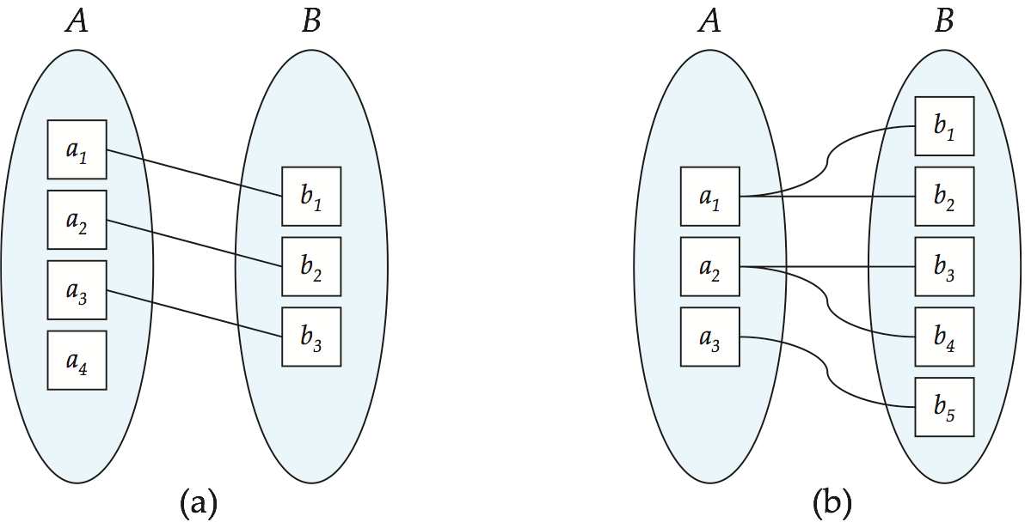
Figure 7.05

Slide 97
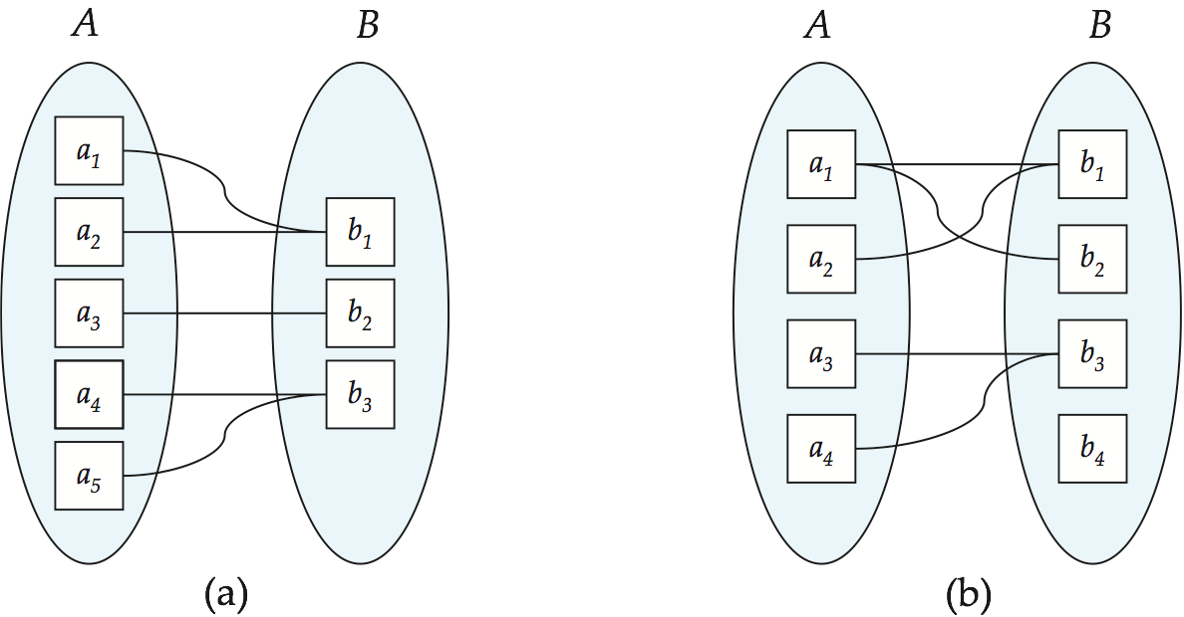
Figure 7.06

Slide 98
Figure 7.07

Slide 99
Figure 7.08

Slide 100
Figure 7.09

Slide 101

Figure 7.10

Slide 102
Figure 7.11

Slide 103
Figure 7.12

Slide 104
Figure 7.13

Slide 105
Figure 7.14

Slide 106
Figure 7.15

Slide 107
Figure 7.17

Slide 108
Figure 7.18

Slide 109
Figure 7.19

Slide 110
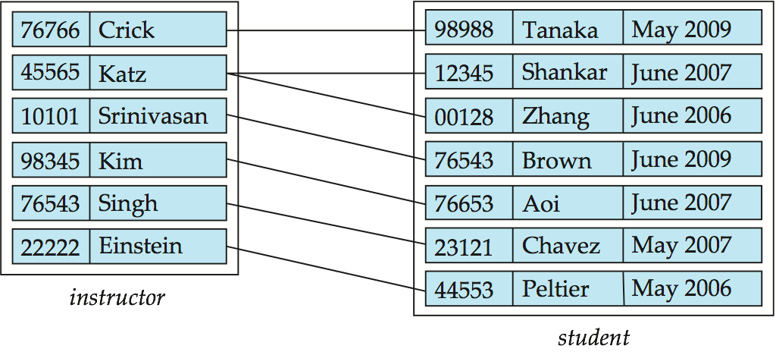
Figure 7.20

Slide 111
Figure 7.21

Slide 112
Figure 7.22

Slide 113
Figure 7.23

Slide 114
Figure 7.24

Slide 115
Figure 7.25

Slide 116
Figure 7.26

Slide 117
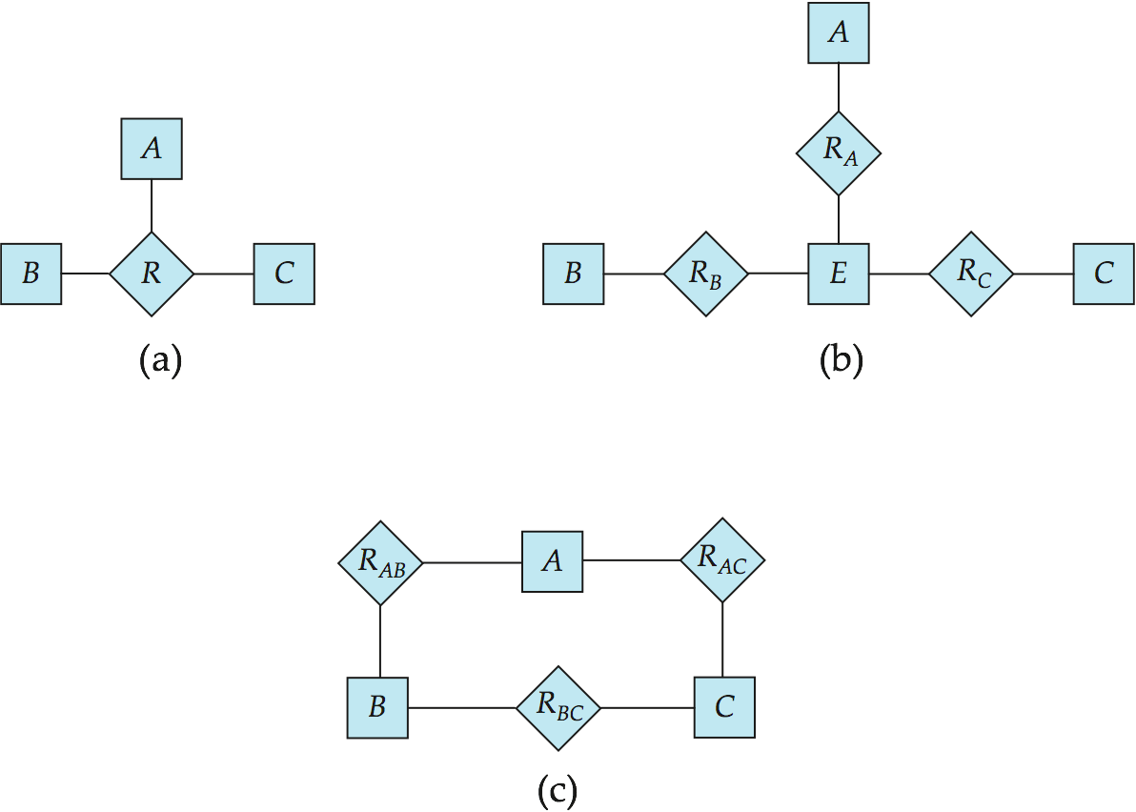
Figure 7.27

Slide 118
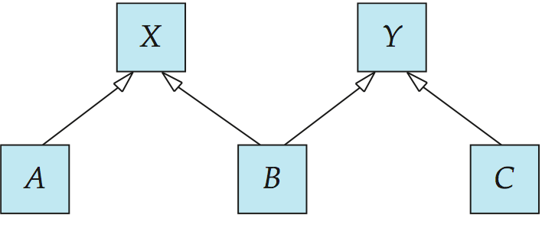
Figure 7.28

Slide 119
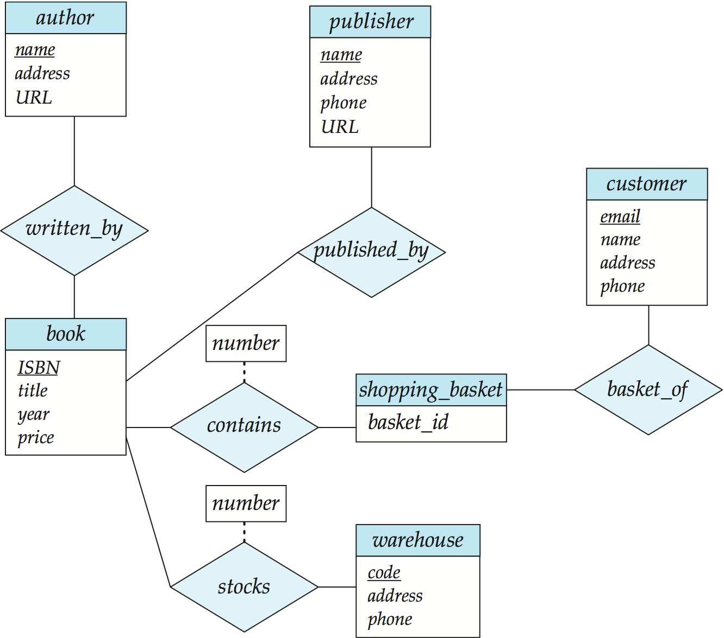
Figure 7.29

